Slide 1
Welcome
VALHSO
Virginia Association of Local Human Services Officials
2019 Winter Legislative Conference
February 1, 2019

Slide 2
About VALHSO
VALHSO
We are an Association of Managers, Administrators and Officials who oversee and coordinate an array of
departments in the Human Services segment of Local Government in the Counties and Cities of Virginia;
We formed an Association in 1989;
We formed an Association because among the various associations and consortiums in the state, there was none that
addressed the administrative issues of local Human Services officials;
We collaborate to improve the delivery of Human Services to citizens and clients, through sharing of best practices, trends
and needs of the people;
We engage in education, advocacy, and influencing public policy in the Human Services segment of government;
We relate to other divisions in local government, as well as other levels of local and state government;
We maintain liaisons with parallel professional and voluntary associations;
We maintain the highest level of managerial excellence, professionalism, and accountability.

Slide 3
Membership
VALHSO
Full Membership $100 – senior human services official from each locality
Special Membership – close affiliates
Associate Membership $75 – others who hold a position associated with human services
Heritage Membership $50 - emeritus

Slide 4
Your Board
VALHSO
Sarah Snead, President – Chesterfield County
Janet Areson, Vice President – Virginia Municipal League, Policy Committee Chair
Nancy Vincent, Treasurer – Falls Church
Kimberly Irvine, Legislative/Conference Chair – York County/ City of Poquoson
Anita Friedman, Policy Co-chair – Arlington
Katie Boyle, Virginia Association of Counties
George Drumwright, Heritage
Brenda Gardner, Heritage
Jim Taylor, Past President - Hanover

Slide 5
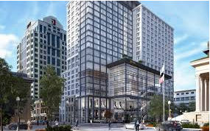
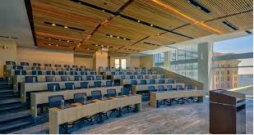
Future Events
VALHSO
SAVE THE DATE!
September 15-17, 2019
Hilton Norfolk, The Main– 100 East Main Street, Norfolk Virginia

Slide 6
Business Meeting Agenda
VALHSO
Treasurer’s Report
Committee Reports
Conference
Legislative
Other Business
Membership
Website – www.valhso.org
Election of Officers
Nominating Committee

Slide 7
Proposed Officers
Report of the VALHSO Nominating Committee
Presented for vote by the Membership at the Legislative Meeting on February 1, 2019
VALHSO
Officers and Board Members:
President: Anita Friedman, Arlington County
Vice-President: Janet Areson, VML (Policy Chair)
Secretary:
Treasurer: Nancy Vincent, Falls Church
Past President: Sarah Snead, Chesterfield County
Legislative/Conference Chair: Kimberly Irvine, York County/ City of Poquoson
Katie Boyle, Virginia Association of Counties
Communications:
Technical: Brenda Gardiner, Heritage
George Drumwright, Heritage
Ad Hoc Committee on CSA:
Leslie Abashian, Chair, Louden County
Sue Rowland, Heritage
Karen Reilly-Jones, Chesterfield County
Jim Gillespie, Fairfax County
Danette Smith, City of Virginia Beach
Janet Areson, VML
Katie Boyle, VACo

