Slide 1


Medicaid and Jails
VALHSO
Suzanne Gore, JD, MSW, Principal
State Health Partners
February 1, 2019
Suzanne.Gore@StateHealthPartners.com
STATE HEALTH PARTNERS
Notes:
Corbel/Raleway BOLD

Slide 2

State Health Partners was founded with the purpose of making health care better - especially for individuals with limited resources or complex health care needs.
We help you create and capture opportunities by understanding the government marketplace, building successful partnerships, and navigating the complexities of Medicaid.
STATE HEALTH PARTNERS
Notes:
This is your about page

Slide 3

Overview
Why Medicaid is Important for Jails
Virginia’s Peculiar Jail System
New Opportunities for Corrections with Medicaid
STATE HEALTH PARTNERS

Slide 4
Why Do Jails Care about Medicaid?

Required to Provide Healthcare
Jails have a Constitutional duty to provide healthcare (8th Amendment).
High prevalence of mental illness and substance use disorders in jails.
Jails are NOT required to cover preexisting conditions.
This impacts access to hospital care.

Preexisting Conditions
Covered
STATE HEALTH PARTNERS
Notes:
The checkmarks are “Webdings” font

Slide 5
Why Do Jails Care about Medicaid?
As of January 1, 2019, most offenders qualify for Medicaid.

Lower Hospitalization Costs for Jails
Savings to Jail Medical Budgets
        Medicaid can pay for inpatient hospital care when a Medicaid-enrolled offender is hospitalized or expected to be hospitalized for at least 24 hours.
Health Coverage at Reentry
Improve health outcomes
Reduce recidivism - especially for individuals with behavioral health or substance use disorder needs.

Support Reentry and Reduce Recidivism
STATE HEALTH PARTNERS
Notes:
The checkmarks are “Webdings” font

Slide 6

Important Partners
Local Departments of Social Services
Community Services Boards
Housing Organizations
Other Human Services Organizations
STATE HEALTH PARTNERS

Slide 7

STATE HEALTH PARTNERS
Notes:
The checkmarks are “Webdings” font

Slide 8
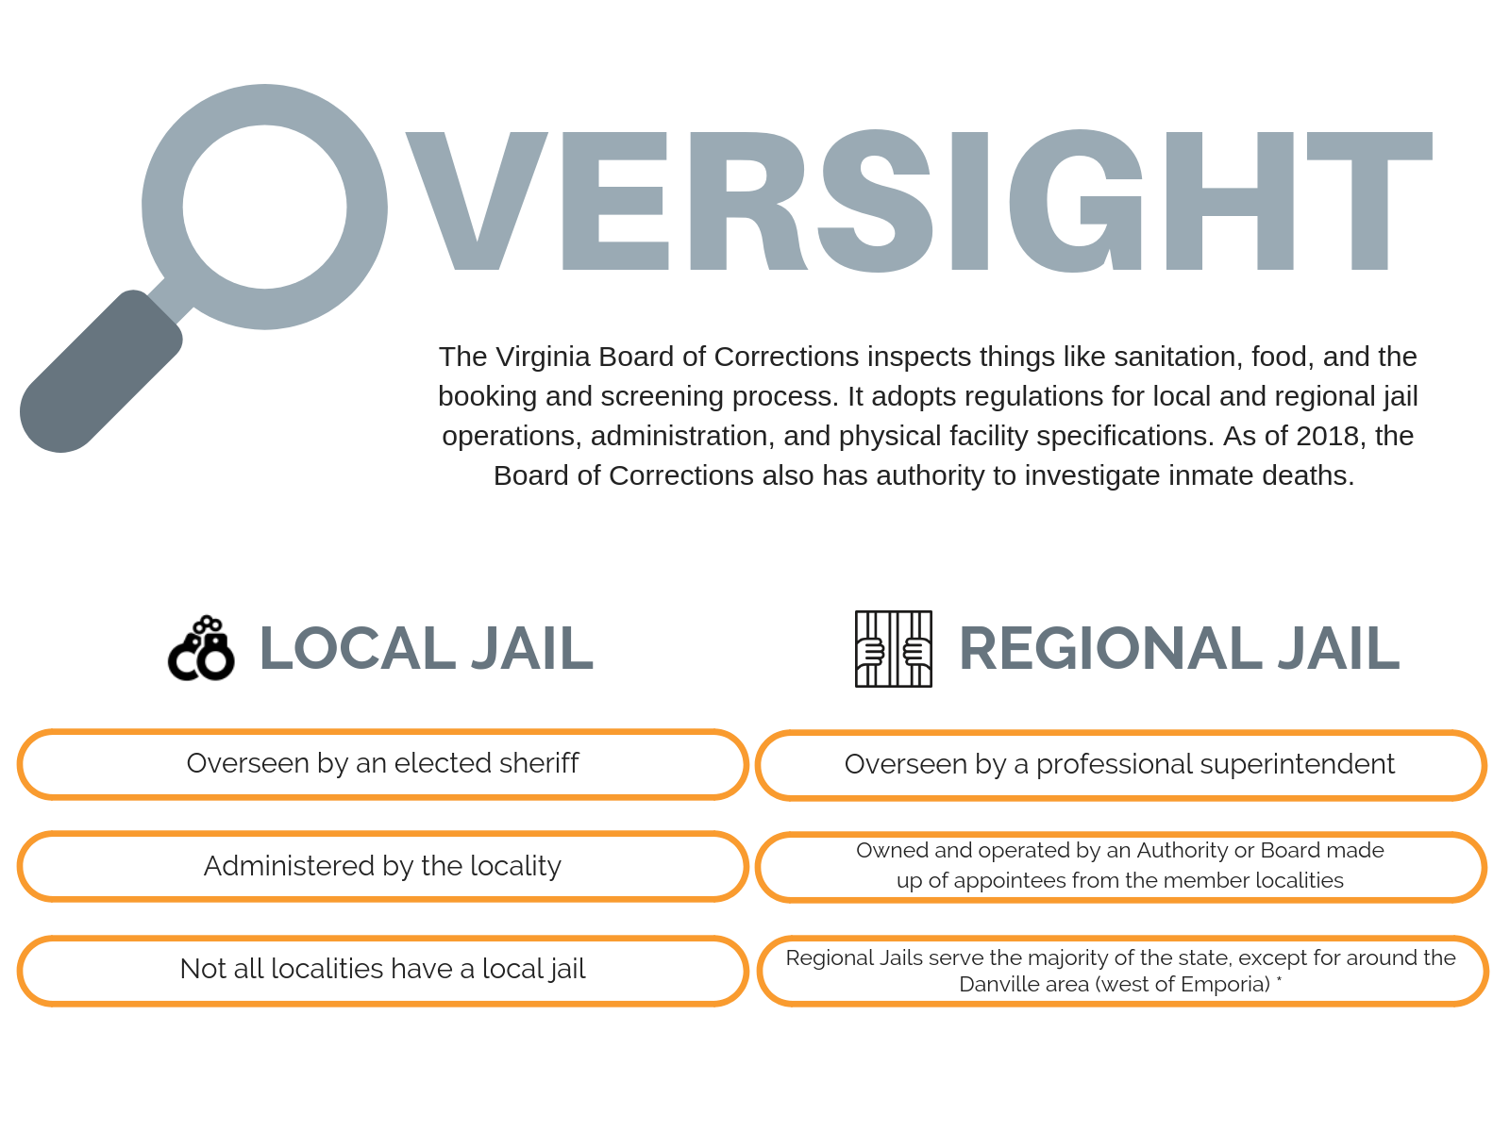
STATE HEALTH PARTNERS

Slide 9

STATE HEALTH PARTNERS

Slide 10
Legislative Direction
(Budget Bill - HB5002 SFY 2019 and 2020)
VA agencies received funding and staff to support new process for offenders.
Inmate Eligibility Unit
Legislative requirement for DMAS to establish a new central application process for offenders
MMIS Access
DMAS soon will allow jails to verify Medicaid eligibility through the Medicaid Management Information System (MMIS)
Data Exchange
Data Exchange between the Department of Corrections (DOC), the Compensation Board, Department of Juvenile Justice, and DMAS and/or CoverVA in development
Pre-Release
Ability to apply for community Medicaid 45 days prior to release
STATE HEALTH PARTNERS

Slide 11

New Inmate Unit at Cover Virginia
Established in November 2018 at Cover Virginia.
Cover Virginia Inmate Unit (CVIU) is trained to work with correctional facilities.
In January 2019, the new Cover Virginia Inmate Unit began taking applications and managing Medicaid eligibility for offenders.
Jail staff now call the CVIU
for offender Medicaid
applications.
STATE HEALTH PARTNERS
Notes:
The checkmarks are “Webdings” font

Slide 12
2019 Medicaid Application Process for Correctional Facilities
1. Identify Potential Applicants
2. Schedule Application Appt. with CoverVA
3. Prepare the Applicant
4. Participate in the CoverVA Application Call
5. Receive Notice of Action
Jails now call 833-818-8752 to schedule offender application appointments, check eligibility, and resolve eligibility issues.
Emergency/Expedited application process available.
Working with hospital social work staff & billing teams to establish protocols
STATE HEALTH PARTNERS

Slide 13

Ongoing Areas of Focus
Ensuring the continuity of Medicaid coverage at reentry:
Connecting with Social Services and CSBs
Connecting with Reentry Organizations
Connecting with Healthcare Coverage Organizations
STATE HEALTH PARTNERS
Notes:
The checkmarks are “Webdings” font

Slide 14
THANK YOU!
Suzanne S. Gore
Principal
suzanne.gore@statehealthpartners.com
804-212-9994
StateHealthPartners.com
Notes:
Thank you page

