Slide 1
Data Governance
Chief Data officer
Carlos rivero

Slide 2
Why Data governance?
To ensure data are sound, secure, and accessible to qualified users
To improve productivity and efficiency
To increase the value of the commonwealth’s data assets by guiding and enabling its evolution from information to intelligence
To promote data discovery, exploration, integration, and sharing through the implementation of enterprise standards

Slide 3
Data value chain
A data value chain describes the evolution of data from information to intelligence within an organization.
It encapsulates the various forms data can take as organizational units transform it to fit their needs.
As such, its inherent value increases the more it is used.
A feedback loop is created when changes to data collection programs are implemented due to the identification of knowledge gaps.
Thus, supporting a virtuous cycle of continuous improvement and increasing the value of the organization’s data assets.

Slide 4
collect
DATA
interpret
INFORMATION
assimilate
KNOWLEDGE
integrate
INTELLIGENCE
Actionable Decisions

Slide 5
Chief data officer
Guides the development of enterprise standards, policies, and best practices to ensure the organization’s data holdings increase in value over time
Liaise between Mission and Technology Programs
Leads enterprise data governance across the Commonwealth
promotes secure data sharing

Slide 6
Management
GUIDES
SUPPORTS
Principles
Architecture
Intelligence
Governance
DRIVES
INFORMS

Slide 7
principles
Used to support mission goals
Interpreted, analyzed, and assimilated to support actionable decisions
Standardized to promote interoperability and integration
Managed to maintain quality, integrity, and reliability
Accessible with appropriate security controls
Disseminated to promote reuse

Slide 8
DATA culture
Establish awareness
Facilitate engagement
Provide inspiration
Promote empowerment

Slide 9
Student engagement
Rural Apprenticeship Program
  Data Documentation and Visualization
  Data Quality Assessments
Commonwealth Data Internship Program
  Exploratory Data Analysis
  Data Modeling
Commonwealth Analytics Fellowship
  Data Analytics
  Predictive Modeling
  Machine Learning

Slide 10
Data science brain trust
Students work on increasingly complex data projects as they mature academically
University faculty collaborate with agency subject matter experts on research proposals to support students and develop algorithms
Innovative businesses “operationalize” algorithms developed by research universities through integration with the stakeholder’s intelligence framework supporting Actionable Decisions

Slide 11
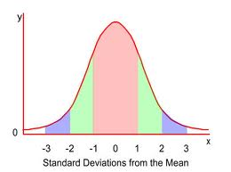
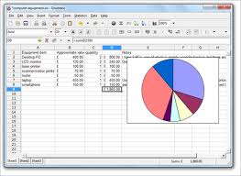
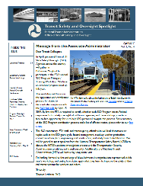
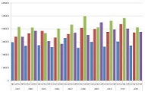

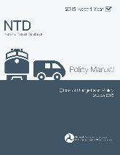
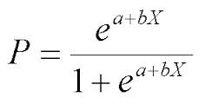
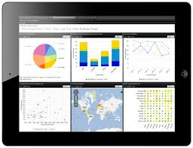



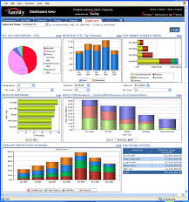
Data
Interoperability supporting integration
and tactical use
Research universities and private businesses conduct analytics research and develop algorithms
Knowledge gaps identified and mitigated supporting Continuous Improvement
DMAS
DSS
Algorithms are ‘operationalized’ and embedded
into commonwealth intelligence products VIA Tech transfer supporting
strategic, tactical, operational levels
VDOT
VDH
DBHDS
DCJS
DEQ
Agency Operations

Slide 12
Immediate goals/actions
Stakeholder Identification and Engagement
Data Governance Research
  Internal (Commonwealth Agencies, Commissions, Boards, and Localities)
  External (State CDOs)
Data and Technology Inventory, Data Dictionary and Catalog
Pilot Projects (Opioid Substance Abuse, Roadway Safety)
Data Sharing Platform

