Slide 1
Department Initiatives Update
Virginia Association of Local Human Services Officials
September 21, 2018
Heidi Dix
Acting Deputy Commissioner for
Compliance, Legislative, and Regulatory Affairs

Slide 2
Presentation Overview
DBHDS Goals
State Hospital Census
STEP-VA
Permanent Supportive Housing
Behavioral Health Transformation
Waiver Priority 1 Wait List

Slide 3
DBHDS GOALS: Innovation, Partnership, Alignment
Expand Access to Services
Continue implementation of STEP-VA
Medicaid Integration
Implement DLA20 to monitor costs and outcomes in CSBs
Improve Facilities
Strengthen Quality & Accountability
Overhaul performance contract with the CSBs
Partner with VHHA to reduce state hospital bed utilization
Advance financial realignment: complete a needs assessment
Complete Roadmap for Future
Plan for the complete build out of STEP-VA services
Develop long-range plan for right-sizing state hospitals
Continue detailed planning for new Central State Hospital
Partner with DMAS, providers, and others to address BH workforce challenges
Ensure Medicaid expansion incorporates STEP-VA
Complete BH Redesign (Farley Center) to create evidence and trauma informed MH services
Increase availability of Permanent Supportive Housing (PSH)

Slide 4
State Hospital Changes Due To Last Resort Legislation
Since “Last resort” legislation was passed, a bed was provided for everyone under a TDO who needed a bed since the law was implemented July 1, 2014.
Since FY 2013, TDO admissions have increased 294% .
Since FY 2013, medical care costs have grown by more than 90%.
In FY 2019, the trend continues as in prior years.

Slide 5
Total TDOs and Hospital Admission Trends

Slide 6
Addressing the Hospital Census
Partnership with VHHA
Established bed search expectations for CSBs that are included in the Performance Contract
Developed contracts with two private hospitals which provide for the admission of individuals who would otherwise go to state hospitals
Require state funded crisis stabilization programs to admit individuals under a TDO and to operate at no less than 75% of capacity
Ensures that emergency services workers consult with developmental disability professionals on any individual with a developmental disability in crisis prior to recommending a TDO
Revisit bed of last resort legislation
Notes:
Ensure adherence to doctor-to-doctor communication for individuals with medical issues
Adopt procedures to escalate admission denials to appropriate facility administrators as needed
Identify trends in the reasons for denial by private hospitals and implement targeted remedial measures

Slide 7
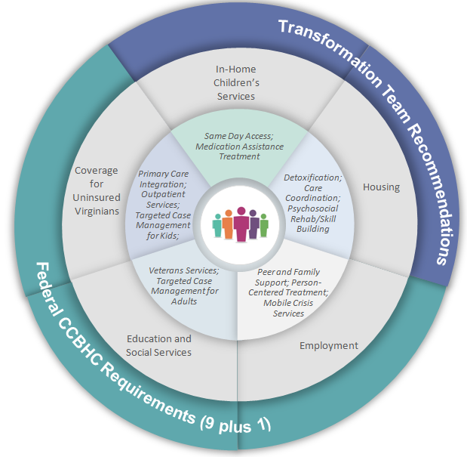
System Transformation, Excellence and Performance in Virginia (STEP-VA)

Slide 8
GA Code-Required Implementation Dates for STEP-VA Services
STEP-VA Service now required by VA Code | GA Implementation Date Requirement | Funds Allocated
Same Day Access | July 1, 2019 | $ 10.8 million in State General Funds
Primary Care Integration | July 1, 2019 | $3.7 million FY19 $7.4 million FY20
Crisis Services for Behavioral Health | July 1, 2021 | –
Detoxification | July 1, 2021 | $2 million FY20
Outpatient Behavioral Health | July 1, 2021 | $15 million FY20
Psychiatric Rehabilitation | July 1, 2021 | –
Peer Support and Family Support Services | July 1, 2021 | –
Veterans Behavioral Health Services | July 1, 2021 | –
Care Coordination | July 1, 2021 | –
Targeted Case Management (Adults and Children) | July 1, 2021 | –

Slide 9
Permanent Supportive Housing
Permanent
Housing is not time limited nor contingent on completion of a program.
Tenancy is maintained through a standard apartment lease.
Supportive
Supportive services are community-based and voluntary.
An array of clinical, rehabilitative, and recovery services are available.
Housing
Housing is affordable and individuals generally pay no more than 30% of income to rent.
Rental housing is integrated in the community.
Services are designed to assist with securing and maintaining housing.
A long-term rental subsidy is required to make housing affordable.

Slide 10
The Essential “Supports” in Supportive Housing
Housing Transition &
Tenancy Sustaining Services
Housing needs assessment
Housing location services
Coordination of transition from institution to community
Tenant education
Landlord mediation
Eviction prevention
Coordination with treatment and rehabilitative supports
Treatment & Rehabilitation
Psychiatry
Outpatient therapy
Assertive Community Treatment
Case Management
Skill Building
Peer Support
Psychosocial Rehabilitation
Supportive Employment

Slide 11
PSH Units Needed by SMI Sub-Population
Data Sources
Jail: Mental Illness in Jails Report (Virginia Compensation Board, 2015)
ALF: Auxiliary Grant payments to localities (Virginia DARS, 2016)
CSB: CSB CCS_3 data submissions (DBHDS, 2016)
Homeless: The State of Permanent Supportive Housing in Virginia, 2015 (Virginia Housing Alliance)
Notes:
ALF = Assisted Living Facility. Congregate board and care homes.
CSB = Top 20% highest utilizers of crisis and emergency services.

Slide 12
Virginia is Building PSH Capacity
Through FY 2018, $9.27 million in Virginia state general funds awarded for PSH for adults with SMI.
Currently funds 700 PSH units
New SMI PSH funding:
FY 2019 $1.5 million
FY 2020 $3.1 million
New PSH target population – pregnant and parenting women with substance use disorders:
FY 2019 $826,200
FY 2020 $1.7 million
Notes:
Since 2016, DBHDS has conducted multiple data matches to assess the impact of PSH on crisis and institutional care.
State psychiatric hospitals
Statewide local hospital inpatient
Sentara Healthcare ED and inpatient
CSB service utilization
Virginia Medicaid
All analyses show outcomes consistent with published PSH research.
High rates of housing stability
Reduced use of costly inpatient, emergency, and crisis care
Increased utilization of community-based behavioral health supports
166 have been in PSH for at least a year. Of the 100 clients who were hospitalized in the year before they were housed, we have a year’s worth of outcomes data for 22 of them. The impact of PSH services for this group’s representation in state hospital facilities and cost avoidances to the state are considerable even though the sample size is small.
Total days spent in state hospital decreased from 2,458 bed days in the year before housing to 149 in the year after housing, a 94% decrease in state facility bed days.
With an average cost of $766/bed day, this reduction in state hospital utilization translates to nearly $1.9 million in avoided hospital bed day costs.

Slide 13
On the Horizon
Medicaid expansion: Housing Transition and Tenancy Sustaining Services.
Interagency coordination with state housing agency partners including Virginia Housing Development Authority (VHDA) and Department of Housing and Community Development (DHCD) and services partners (DBHDS, DARS, DMAS).
Improving the transition of vulnerable individuals from institutions such as correctional facilities and hospitals into PSH.
New PSH funding for pregnant and parenting women with substance use disorders.

Slide 14
Behavioral Health in the Commonwealth of Virginia Opportunity for Transformation
Medicaid is the largest payer of behavioral health services in Virginia
$$$
40th in the country overall for mental illness prevalence and access to care
47th in the country for child mental illness prevalence and access to care
(mentalhealthamerica.net)
of Medicaid members had either a primary or secondary behavioral health diagnoses
28%
Notes:
Add notes here that summarize the state of Medicaid-funded behavioral health care in the commonwealth.
We pay for most of it
Our members have a high prevalence of BH dx and need for service
Compared to other states, we have high prevalence and problematic access
NOTE FROM ALYSSA: We would like to start with this slide to get straight to the point. What is the consolidated stat from MHA that references a 40th ranking? Kate was mentioning this at our meeting. We’d prefer that stat to the 23rd ranking…

Slide 15
Medicaid Expenditures on Community-Based Medicaid Mental Health Services
$564 Million
Notes:
Add notes here to present systems observations around cost:
The top 3 expenditures are for intensive service types (mental health skill building for adults, therapeutic day treatment and intensive in home for youth) and trends over the last four years indicate they are becoming more and more costly. (Internal note: This is driven by a number of factors, some of which the transformation process hopes to elucidate and address)
Maybe consider having an animation at this point that lays over this graphic to emphasize that nearly 600 million were spent on these services in 2017. (Note: I’d like to have on hand the number of members served across those categories) I added this is as a sample

Slide 16
Momentum for Behavioral Health Transformation
STEP-VA services will improve access, increase quality, build consistency and strengthen accountability across Virginia’s public behavioral health system.
A strong public behavioral health system provides a necessary foundation
University of Colorado Farley Center will collaborate with DMAS, DBHDS, and stakeholders to examine community mental health rehabilitation service (CMHRS)
Notes:
Alexis to add a slide here?

Slide 17
Timeline: Deliverables / Products
October 2018
Evidence Review & Service Gap Analysis
December 2018
Recommendations for service array and licensing/regulation
January 2019
Recommendations for measures and metrics
Notes:
The deliverables asked of the Farley center will follow this expected timeline.
Final deliverable dates:
October 12: evidence review and service gap analysis reports
January 1: measures & metrics and licensing & regulations recommendations report due; Evidence-based continuum of mental health services recommendations
April 30: Stakeholder report
October: Evidence review and service gap analysis
December: Recommendations for measures and metrics, and licensing and regulations
January: Recommendations for Evidence-based continuum of mental health services
February: Convening to discuss recommendations for the continuum of services
Remainder of 2019: continued implementation planning
2020: VA’s proposed beginning of transformation Implementation

Slide 18
Anticipated Outcomes
Alignment:
Recommendations to align Medicaid behavioral health services with DBHDS licenses to create a continuum of evidence-based, trauma-informed, prevention-focused and cost-effective service options for members across the lifespan
Accountability
Recommendations on outcome measures that incentivize high quality services in least restrictive environments
Access
Recommendations to expand access through a “no wrong door” approach for members across a full array of services delivered in settings where they naturally present for support.
Recommendations to expand access to service types and therapeutic interventions that are best practices and well-matched to members’ level of impairment / support need.
Notes:
As a result of this collaboration, our anticipated outcomes include:
alignment……
Accountability…..
Accessibility….
And the path forward to achieve our vision.

Slide 19
Developmental Disabilities Waivers
DBHDS received $15.4M in FY19 and $37.4M in FY20 for waiver slots. DBHDS has remixed slots across three waivers to allow more slots to be distributed, as the more expensive CL slots are swapped for more slots in the less expensive waivers. The remix increases the number of authorized slots over the biennium from the 825 included in the Governor’s Budget to 1,319.
DBHDS has plan to eliminate Priority 1 wait list by FY 2022 based on current funding, future remix of Settlement Agreement slots, and turnover slots.
Priority One Waitlist by Year
Fiscal Year | # of Individuals Waiting | % Change to FY18 Base
FY 2018 | 3,451
FY 2019 | 2,878 | -17%
FY 2020 | 1,642 | -52%
FY 2021 | 497 | -86%
FY 2022 | 2 | 100%

Slide 20
On the Horizon /Other Key Topics
Additional substance use disorder funding
Recovery residences
Children’s mental health
Mental health standards in jails

Slide 21
Contact Information
Heidi Dix
Acting Deputy Commissioner for Compliance, Legislative, and Regulatory Affairs
Department of Behavioral Health and Developmental Services
Heidi.Dix@dbhds.Virginia.gov

