Slide 1
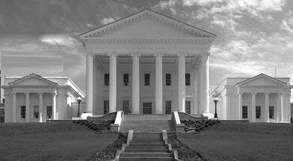
Virginia’s Opioid Overdose and Addiction Epidemic Response Virginia Association of Local Health Services Officials 2019 Conference
Jodi Manz, MSW
Assistant Secretary of Health and Human Resources
February 1, 2019

Slide 2
All drugs
The total number of fatal drug overdoses statewide has increased each year. In 2013, fatal drug overdose became the number one method of unnatural death in the Commonwealth, surpassing both motor vehicle-related fatalities and gun-related fatalities. In 2014, fatal drug overdose became the leading cause of accidental death in Virginia. The number of all fatal overdoses in 2016 compared to 2015 increased by 38.9%---a record setting statistic. In 2017 compared to 2016, fatal overdoses increased 7.4%.

Slide 3
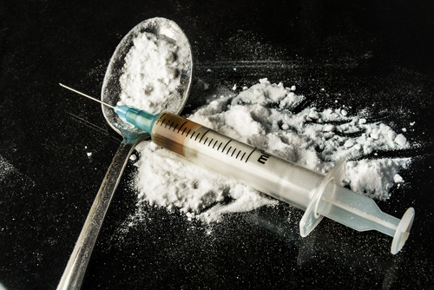
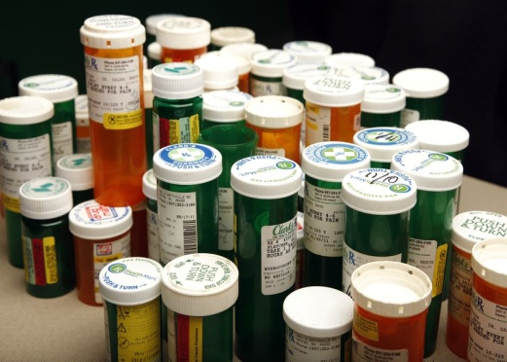
Opiate Versus Opioid
Natural | Semi-synthetic | Synthetic
codeine | hydrocodone | methadone
morphine | oxycodone | fentanyl
*heroin | meperidine | tramadol
 | hydromorphone
 | oxymorphone
 | buprenorphine
Your body makes its own opioids, which are called “endorphins.”
Notes:
Opiates are natural poppy derivatives, opioids are morphine derivatives. FENTANYL

Slide 4
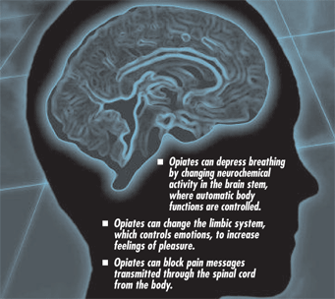
Similarities between Heroin and Prescription Opioids
Notes:
Why do we talk about these things together? Molecularly, it’s like Coke v Pepsi. Heroin is cheaper, and with protective policies put into place around pharmaceuticals, often easier to obtain.

Slide 5
Opioids- A Different Perspective
Prescription opioids are a group of drugs that are commercially made by pharmaceutical companies in certified laboratories that act upon the opioid receptors in the brain. Historically, fentanyl has been one of these drugs. However, in late 2013, early 2014, illicitly made fentanyl began showing up in Virginia and by 2016, most fatal fentanyl overdoses were of illicit production of the drug. Separating fentanyl from the grouping of prescription opioids for this reason demonstrates a slight decrease in fatal prescription opioid overdoses in 2015 and a dramatic increase in the number of fatal fentanyl and/or heroin overdoses. This has caused the significant rise in all fatal opioid overdoses in the Commonwealth since 2012.
¹ ‘All Opioids’ include all versions of fentanyl, heroin, prescription opioids, and opioids unspecified
² Illicit and pharmaceutically produced fatal fentanyl overdoses are represented in this analysis. This includes all different types of fentanyl analogs (acetyl fentanyl, furanyl fentanyl, etc.)
³ ‘Prescription Opioids (excluding fentanyl)’ calculates all deaths in which one or more prescription opioids caused or contributed to death, but excludes fentanyl from the required list of prescription opioid drugs used to calculate the numbers. However, given that some of these deaths have multiple drugs on board, some deaths may have fentanyl in addition to other prescriptions opioids, and are therefore counted in the total number. Analysis must be done this way because by excluding all deaths in which fentanyl caused or contributed to death, the calculation would also exclude other prescription opioid deaths (oxycodone, methadone, etc.) from the analysis and would thereby undercount the actual number of fatalities due to these true prescription opioids.

Slide 6
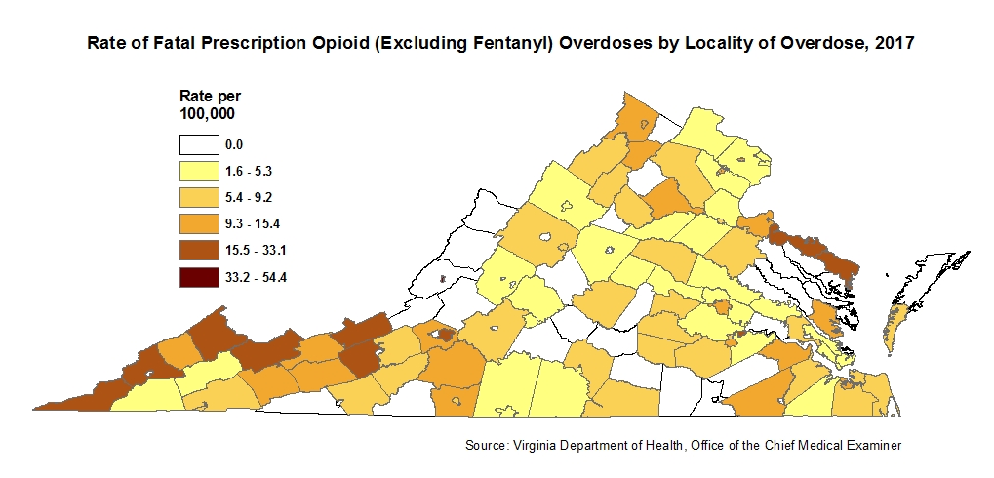
Prescription Overdose Deaths: Rural Concentration

Slide 7
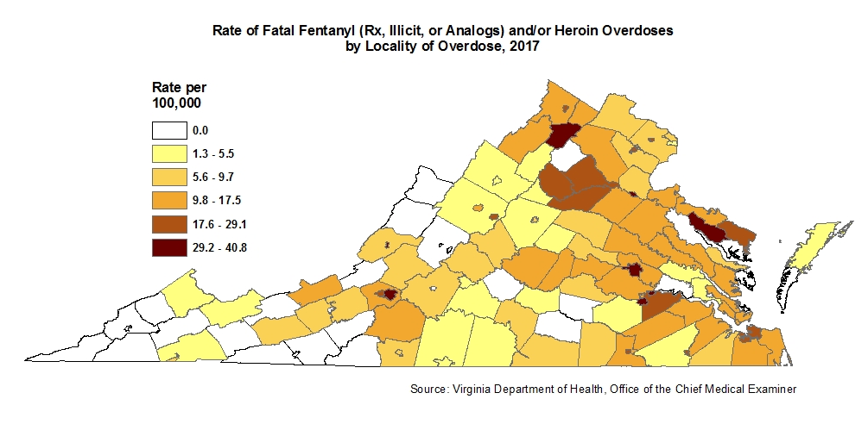
Fentanyl and Heroin Overdose Deaths: Urban/Ex-Urban Concentration

Slide 8
Coordinating a Crisis Response
Previous Governor’s Task Force on Prescription Drug and Heroin Abuse (2015)
Commissioner of Health declared a public health emergency (2016)
Coordinating body: Governor’s Executive Leadership Team on Opioids and Addiction (2017 – present)
Co-chaired by Secretary of Health and Human Resources and Secretary of Public Safety and Homeland Security
Led by 5 work groups to facilitate interagency work
Integrates existing work and Governor Northam’s Transition Council recommendations
Stakeholder Commission (2018 - present)

Slide 9
Governor’s Executive Leadership Team on Opioids and Addiction
Co-chaired by Secretary of Health and Human Resources and Secretary of Public Safety and Homeland Security
Harm Reduction
Abuse Prevention
Supply Prevention
Justice-Involved Interventions
Treatment and Recovery
Establish operational comprehensive harm reduction programs in Virginia
Build the capacity of Virginia’s communities to address the addiction epidemic through community mobilization and coalition development
Limit availability of Rx opioids for misuse
Develop model protocols for MAT for individuals that are being released from correctional settings that local/regional jails and CSBs can use to implement
Establish pathways to treatment and recovery supports in Virginia

Slide 10
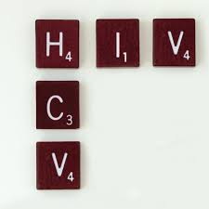
Harm Reduction
Led by Virginia Department of Health
Establish operational comprehensive harm reduction programs in Virginia
Comprehensive Harm Reduction (CHR) includes HIV/HCV testing, referrals to treatment, referrals to SUD treatment, and exchange of used syringes for clean
0 to 3 existing sites in 2018 (Wise, RVA, Smyth Counties)
Early stats (Wise County)
29 participants
3200 used syringes collected
1900 distributed
4 naloxone saves by participants
Ability to develop programs sunsets in 2020
Additional objectives
Naloxone availability
Decreasing NAS
Increasing treatment capacity for Hep C

Slide 11
Abuse Prevention
Led by Department of Behavioral Health and Developmental Services (DBHDS)
Build the capacity of Virginia’s communities to address the addition epidemic through community mobilization and coalition development
CCOVA support for coalition development
Partnering with local government offices
Additional objectives
GF dollars toward prevention
Developing ACE-prepared communities

Slide 12
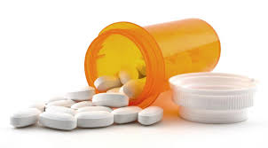
Supply Prevention
Led by Department of Health Professions
Limit availability of prescription opioids for misuse.
Drug take-back sites
63 existing drop boxes + 32 CVS sites + 5 private pharmacies + 20 law enforcement offices = 120 operating drop boxes
2017 Prescribing regulations have significantly reduced supply available for diversion
Regs DO NOT make all opioid prescribing illegal or impossible
Additional objectives
Addiction treatment education (waivers)
~ 1600 waivered, not all prescribing
Alternative pain management education
Education with emerging medical and allied health professions
Governor’s Grand Rounds
Core Curricula development

Slide 13
Justice – Involved Initiatives
Led by Department of Corrections
Develop model protocols for Medically Assisted Treatment (MAT) for individuals that are being released from correctional settings that local/regional jails and CSBs can use to implement.
Naltrexone Pilot: Voluntary participants returning to 3 areas of Virginia with high incidence of opioid overdose + CSB with OUD services + strong drug court (Norfolk, Richmond, and Southwest VA)
Additional objectives
Include Buprenorphine MAT
Increase Medicaid enrollment
Provides injectable naltrexone (via Alkermes MOU) upon re-entry
MAT and psycho-social interventions continued post-release through Community Services Board (CSB)
Collaborative Supervision: Recovery Navigator, Probation Officer, CSB staff, participant

Slide 14
Treatment and Recovery
Led by DBHDS
Establish pathways to treatment and recovery supports in Virginia
Increase number of CSBs providing evidence-based treatment (36)
Increase number of FQHCs providing evidence-based treatment (3)
Additional objectives
Treatment workforce development (waivers)
Increase addiction treatment capacity (actual prescribing and psycho-social interventions)
Recovery in the community
workplace
collegiate
housing

Slide 15
Medicaid Addiction and Recovery Treatment (ARTS) benefit
Medicaid Addiction Recovery and Treatment Services (ARTS) benefit through 1115 waiver
Implemented Medicaid prescribing guidelines building on ARTS momentum and collaboration

Slide 16
Promoting Medically Assisted Treatment (MAT)
Biopsychosocial disorders require biopsychosocial interventions
Not all substances have biological interventions available
Interventions must be simultaneous and ongoing (sometimes for a lifetime)
Medically Assisted Treatment options for opioids
Naltrexone (implant, oral, or injectable therapy, low abuse potential)
Buprenorphine (oral or injectable replacement therapy, usually + naloxone, abuse potential but not deadly)
Methadone (replacement therapy, highly regulated, abuse potential)
Replacement therapy is just that. It IS replacing one drug for another.
Stigmatized in both recovery and professional settings
Defining behaviors of SUD
Biologically necessary

Slide 17
Responding to the Federal Response
Leveraging and aligning funding opportunities from SAMHSA, CDC, USDA, HRSA, BJA, DOL, NIH
Dismantle stigma that poses barriers to prevention and treatment
Reduce impacts of addiction (reduce deaths)
Build infrastructure to prevent and treat addiction through workforce supports and development
Notes:
82 meth deaths, 1 in 2010; 387 cocaine, 80 in 2009

Slide 18
Allocating SAMHSA funds
State Targeted Response (STR) Grant, 2017-18, $9 M
Nearly entirely allocated to CSBs for prevention, treatment, and recovery services
State Opioid Response (SOR) Grant, 2018, $16 M
Significant allocations to CSBs for prevention, treatment, and recovery services
Other major projects supported (not exhaustive):
University research-led evaluation
Peer supports (professional development and peer placement)
Naloxone purchasing
Harm reduction supports
University recovery program development
Media awareness campaign
Supports for Tx at FQHCs

Slide 19
Allocating CDC Funds
Cooperative Agreement for Emergency Response: Public Health Crisis Response, 2018, ~$5
Project Period: September 1, 2018 –August 31, 2019
Incident Management $40,000
Jurisdictional Recovery $1.8 M
Biosurveillance $1.3 M
Information Management $1 M
Countermeasures and Mitigation 900,000

Slide 20
Leveraging Opioid Data
Data sharing barriers exist at local, state, and federal levels and across professional arenas
In 2018, GA created a Chief Data Officer position
~$400,000 federal Bureau of Justice Assistance grant (DCJS)
Qlarion (vendor) piloting a criminal justice and health/behavioral health data sharing platform in Winchester, Virginia
Provides a model for data sharing across systems
2019 Governor’s budget amendment ($1.3 M) to support data sharing and data governance

Slide 21
2019 Opioid-Related (Currently live) Legislation
Bill Number (Patron) | Bill content
HB1743 (Bulova) | Adds proper disposal to counseling done by pharmacists
HB1878 (Garrett) | Authorizes regional jail employees to possess and administer naloxone
HB2045 (Hurst) | Creates a certification for recovery housing
HB2559 (Pillion) | Lays out exceptions for e-prescribing mandate
HB2318 (McGuire) | Authorizes school nurses to possess and administer naloxone
HB2158 (Plum) | Expands authorization to dispense naloxone
HB2558(Pillion)/SB1167(Chafin) | Prohibits providers from insisting on cash payment for SUD treatment services from Medicaid members

Slide 22
2019 Budget Amendments
Governor’s budget amendments:
$3.2 M ($1.6 in both years) for naloxone
$1.3 (FY20) for data sharing and governance
Specifically, ~$800,000 for a data dictionary and catalog that builds on pilot
$3.3 M (FY20) for the Department of Forensic Services additional controlled substances positions
$1.1 M (FY20) for treatment programs in Community Corrections Alternative Programs (CCAP)
Legislative committee reports forthcoming...

Slide 23
Addiction will always find another drug.

Slide 24
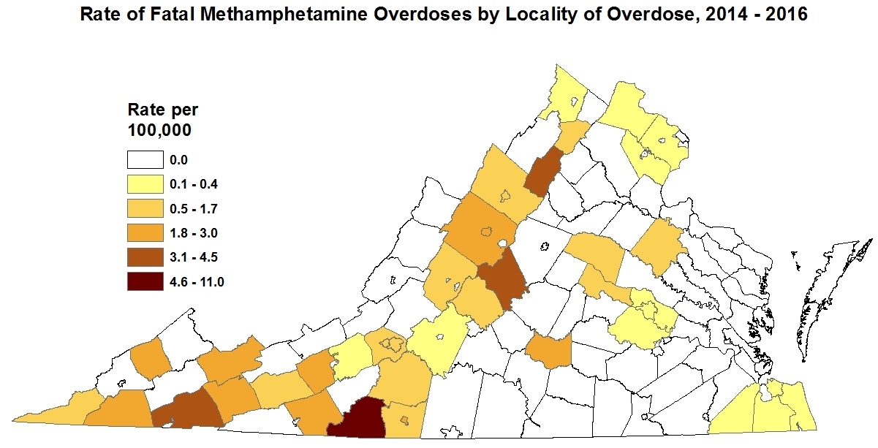
Methamphetamine Overdose Deaths

Slide 25
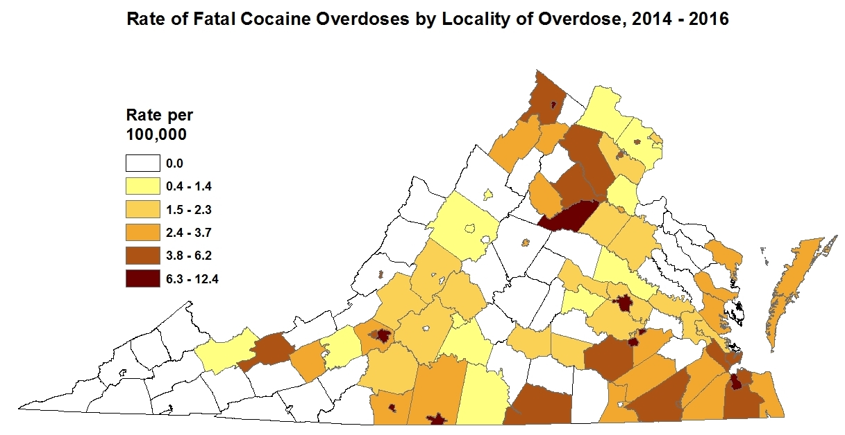
Cocaine Overdose Deaths

Slide 26
Questions & Contact Info
Jodi Manz
Jodi.Manz@governor.virginia.gov
(804) 663-7447
Task Force Website http://www.dhp.virginia.gov/taskforce/default.htm
State Opioid and Heroin Resource Website
Curbthecrisis.com

