Slide 2
Executive Order No. 11
Established the Children’s Cabinet, which is comprised of:
First Lady of Virginia
Lieutenant Governor
Secretary of Agriculture and Forestry
Secretary of Education
Secretary of Health and Human Resources
Secretary of Public Safety and Homeland Security

Slide 3
Children’s Cabinet Priority Areas
Nutrition and Food Security
Early Childhood Development and School Readiness
Systems of Care
Student Safety
Trauma-Informed Care

Slide 4
Nutrition and Food Security Work Group
Goals:
Expand access to nutritious food and decrease food insecurity for pregnant women.
Expand access to nutritious food and decrease food insecurity for children.
Promote community-based food systems to increase access to healthy, local foods.
Ongoing Children’s Cabinet Action Items:
Childhood Hunger Blueprint Report
Hunger Vital Signs
Recent progress in this field:
Feed VA Day of Action – Over 60 volunteer events held across Virginia highlighting food access, nutrition, health, and education.
In 2018, 58 public school divisions and 4 private schools adopted a Community Eligibility Provisions (up from 47 divisions in 2017)

Slide 5
Early Childhood Development and School Readiness
Stakeholder discussions on how Virginia can improve its early childhood system and what actions can drive those changes
Discussions around VKRP, VPI+, home visiting, and other programs and initiatives operating across the Commonwealth in communities with different needs are informing next steps
Recent progress in this field:
Expanded VKRP to get better data
Funding and investments from 2018 Session
Received $9.9 million Preschool Development Grant
“Early Childhood Success Act” is currently pending in House and Senate; Calls for a uniform rating system, plan for improving state-level governance

Slide 6
Investing Early
Investing in improving kindergarten readiness is a smart business investment.

Slide 7
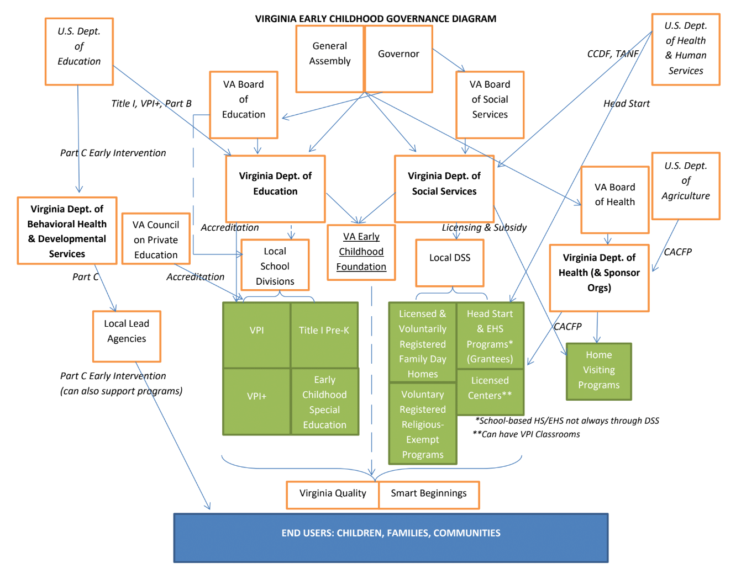
Current State of Oversight
Governance structure makes it difficult to measure and strengthen our early childhood system – at both state and local levels.

Slide 8
By 2022: What Success Looks Like
By 2022, more Virginia children will enter kindergarten ready.
More Virginia families have affordable access to early childhood care and education that supports learning across the birth through 3rd grade continuum and meets their unique needs.
With a shared definition of school readiness, Virginia families and early childhood programs work together to ensure children thrive, developing the skills needed for kindergarten and beyond.
Virginia has unified quality standards for all publicly-funded early childhood programs that are indicative of child outcomes. Virginia measures and rewards programs for performance, ensuring leaders and teachers are well compensated for their achievement.
Overall Virginia’s early childhood system will be more unified, transparent, data-driven and resource-effective, with no funding “left on the table.”

Slide 9
Systems of Care – Student Safety
Wide variety of facilitated discussions and presentations
Recommendations focused on six primary areas
Enhance Information-Sharing and Effectiveness of Threat Assessment Teams
Role and Prevalence of School Resource Officers and School Security Officers
Suicide Prevention
Staffing Levels and Ratios of School Counselors and Support Staff
Community, School, and University Educational Training
Physical Security
Recent progress in this field:
Virginia received over $869,000 in federal funding to support threat assessment in schools
Virginia awarded 33 localities $1.2 million in grants for SRO and SSO positions

Slide 10
Systems of Care – Trauma-Informed Care
Work group provided four interim recommendations to legislature last month:
State agencies should adopt the The Substance Abuse and Mental Health Services Administration (SAMHSA) definition and framework of trauma-informed care.
Governor should convene an internal “Trauma-Informed Care (TIC) State Steering Committee” led by Governor’s staff consisting of state agency leaders
The TIC working group should develop a strategic plan for recruiting, training, and supporting a trauma-informed workforce in Virginia’s child and family-serving sectors.
The TIC working group should develop a dashboard of short and long-term metrics the executive, legislative, and judicial branches can use to assess Virginia’s progress in developing a trauma-informed workforce and system of care, as well as the positive outcome measures state leaders should expect to see as a result.

